Slide 1
CKLN: A POTENTIAL TOOL FOR U.S.-CARIBBEAN ENGAGEMENT?
Bernard E. Link
Chargé d'Affaires a.i.
United States Embassy Grenada
Fax: 473-444-4820
Phone: 473-444-1177 ext. 228
Email: linkbe@state.gov

Slide 2
Embassy St. George’s

Slide 3
The Pitch
Develop a proposal for a public-private partnership to work with Caribbean colleges and universities in order to generate ideas and develop tools that show how the Caribbean Knowledge and Learning Network can contribute to their academic missions.

Slide 4
Caribbean Knowledge and Learning Network
Current Status
-- A CARICOM Agency
-- Regional Network Architecture under construction
-- Batting Line-up of National Networks: DR, Jamaica, Trinidad and Barbados
-- Funding for 2.5 years of operation

Slide 5
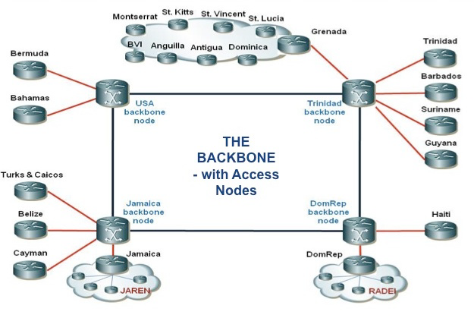

Slide 6
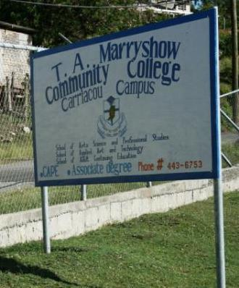
Caribbean Knowledge and Learning Network
Issues
-- Business model still under development.
-- State of development of national nodes varies.
-- Will system compete with or complement UWI and other major universities’ distance learning systems?

Slide 7
The Hurdle- Are Risks Clearer than the Benefits?
-- Will new technology shake up time-tested teaching techniques?
-- Who controls the curriculum?
-- Will small, local institutions lose autonomy to regional powerhouses?
-- Is the new technology affordable?

Slide 8
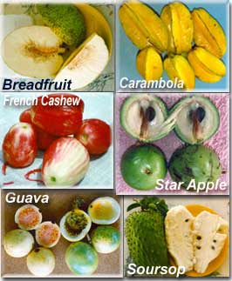
CKLN Project Fair
Invite local institutions to generate ideas for making CKLN relevant to them.
Submit proposals to a grant competition to implement the ideas.
Work alongside experienced outside institutions to develop and implement projects.

Slide 9
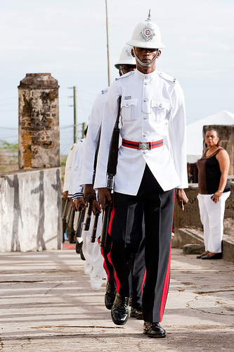
Elements of Current U.S. Engagement
Caribbean Basin Security Initiative (1)
Objectives
-- Reduce Illicit Trafficking
-- Promote Public Safety and Security
-- Promote Social Justice

Slide 10
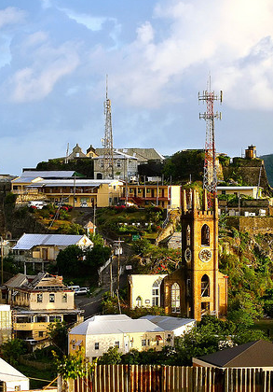
Elements of Current U.S. Engagement
Caribbean Basin Security Initiative (2)
-- Equipment and Supplies
-- Training Opportunities
-- Coordination among Police, Defense and National Security Entities

Slide 11
Elements of Current U.S. Engagement
Youth Skills Development (USAID)
Job Skills/Life Skills Project (With the International Youth Foundation)
Job Opportunity for Business Scale-Up (JOBS -With the University of the West Indies Business School and Kelley School of Business)

Slide 12
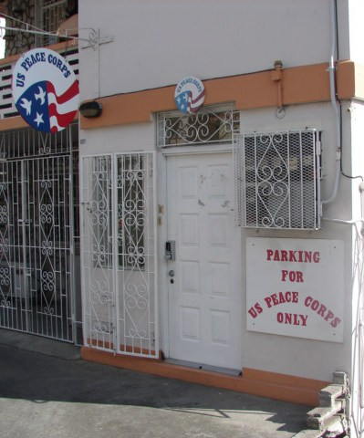
Elements of Current U.S. Engagement
Outreach on Education
-- CETT
-- Fulbright Program
-- Peace Corps
-- Book Donations
-- Poster Shows
-- Education USA Counselors and College Fairs
-- CXC Award and Other Special Events

Slide 13
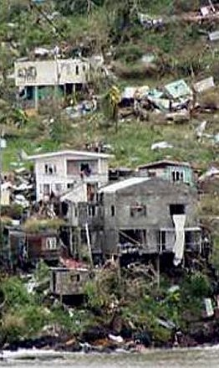
Elements of Current U.S. Engagement
Health and Science
-- President’s Emergency Program for AIDS Relief
-- Disaster Preparation and Response

Slide 14
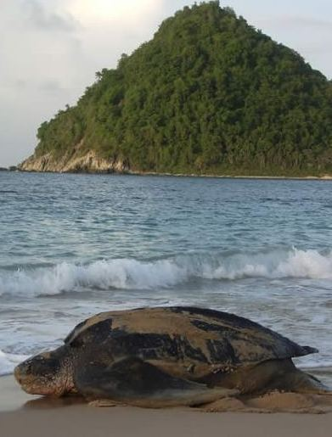
Elements of Current U.S Engagement
Environment & Climate
-- Finalization of Geothermal Legislation (ECPA & OAS)
-- Climate Change Adaptation Fund (AID & OECS)
-- Mangrove Mapping Project (FWS and Grenada Fund for Conservation)
-- GIS Mapping Project (SUSGREN and NOAA)

Slide 15
Thanks!

